Slide 1
Foundation of computer science
By Mohamed Agami

Slide 2
Lecture 2

Slide 3
Form factor

Slide 4
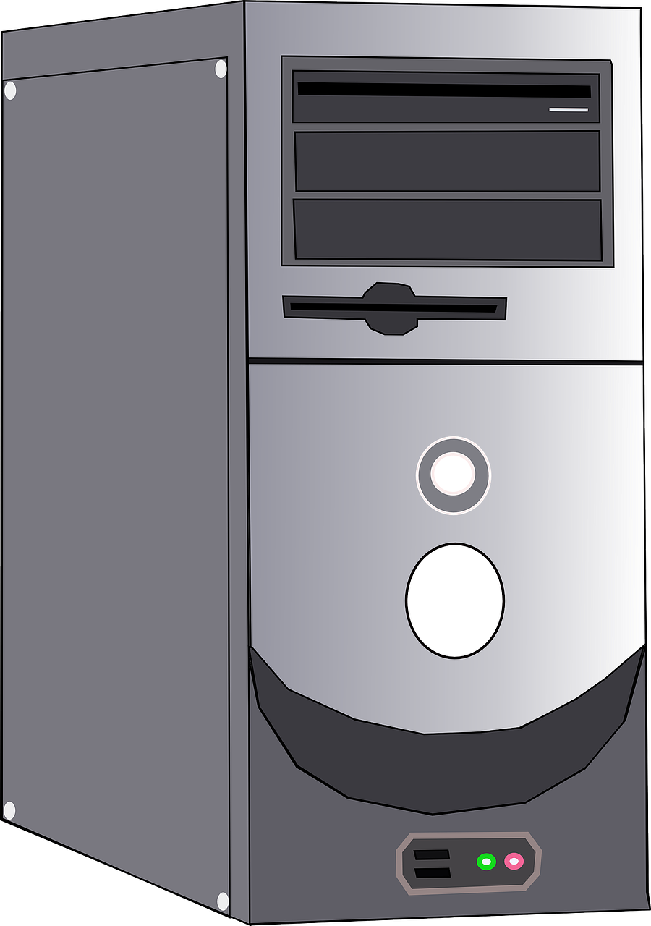
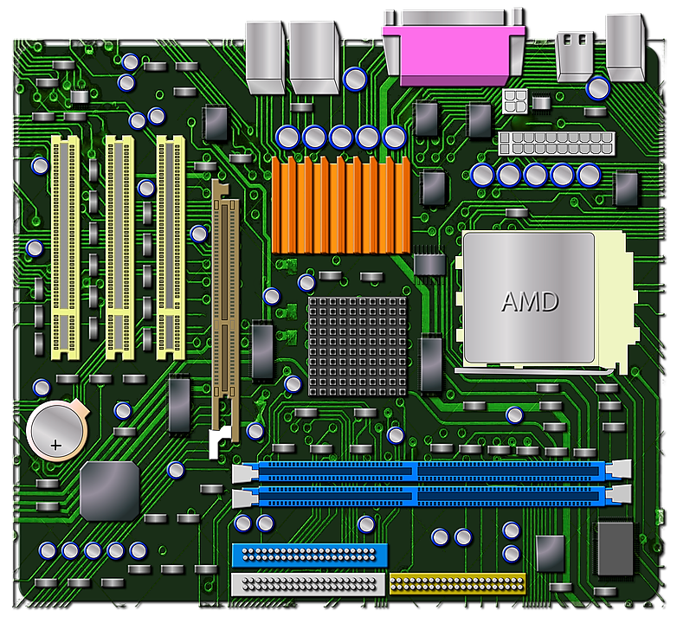
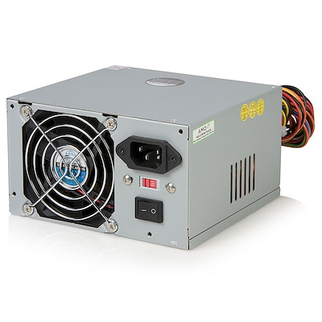
Size
Shape
Major feather
Form Factor

Slide 5
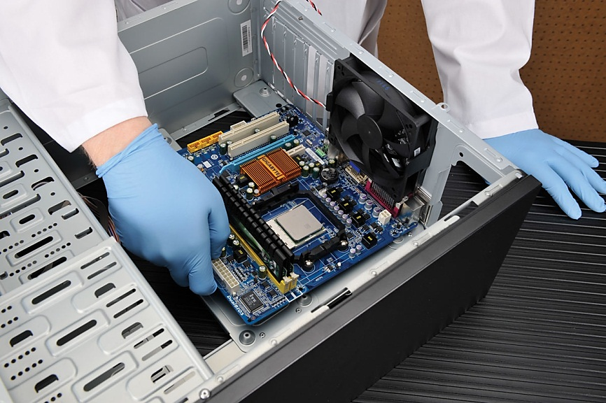
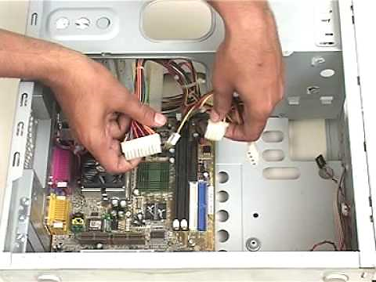
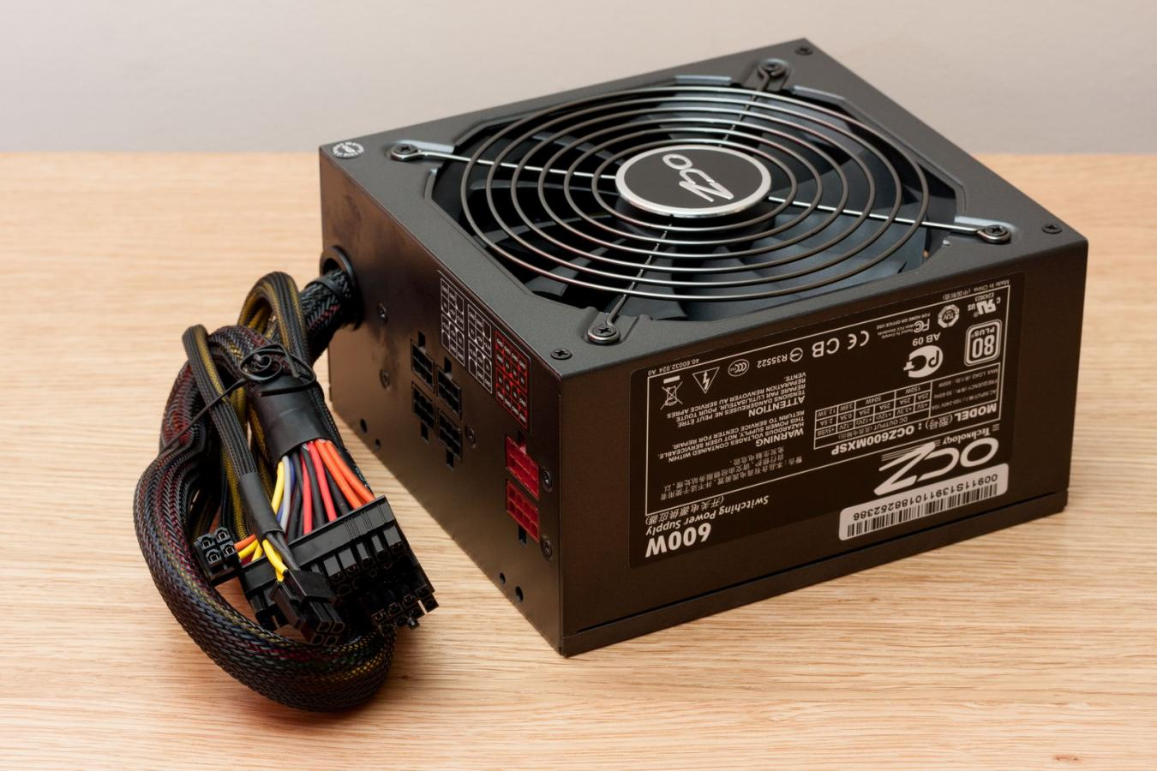
Collection computer components
Choosing a matching form factor for the motherboard, power supply, and case ensures that

Slide 6
Type Of Form Factor
ATX
Micro ATX
BTX
Mini-ITX
EATX
Flex ATX
NLX

Slide 7
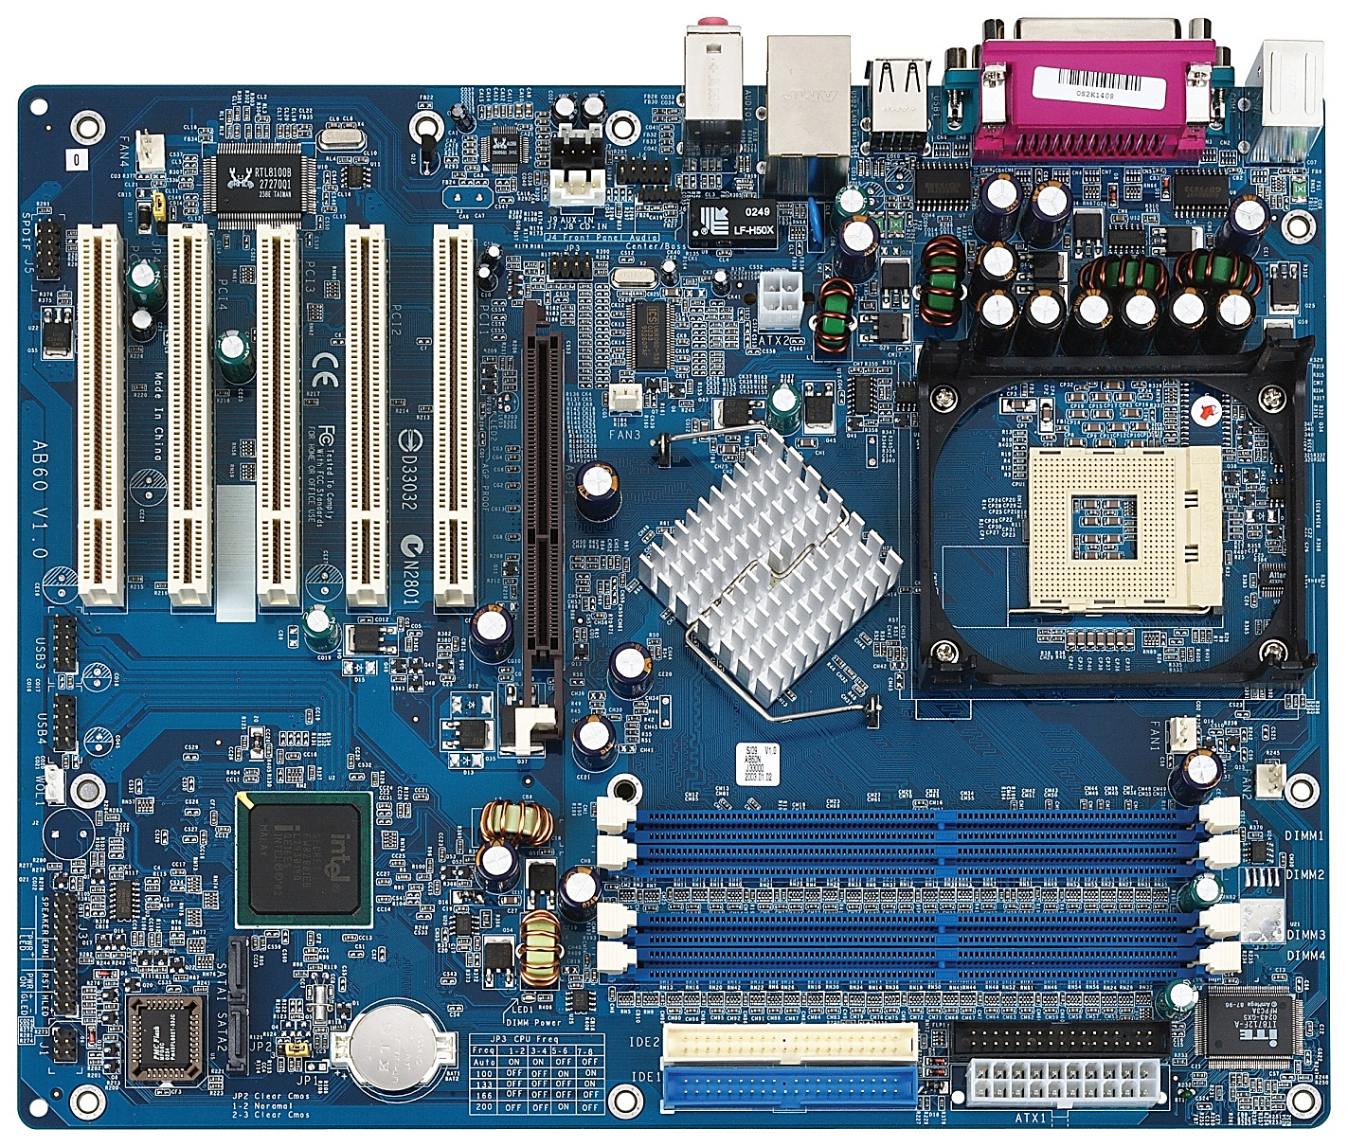
CPU Socket
PCI Slots
RAM Slots
Video card
Slots
P1 connector

Slide 8

ATX Form factors
ATX sands Advanced Technology eXtended
It was developed by Intel in 1995
12 Inch
Its dimensions are 12*9.6
9.6 Inch

Slide 9
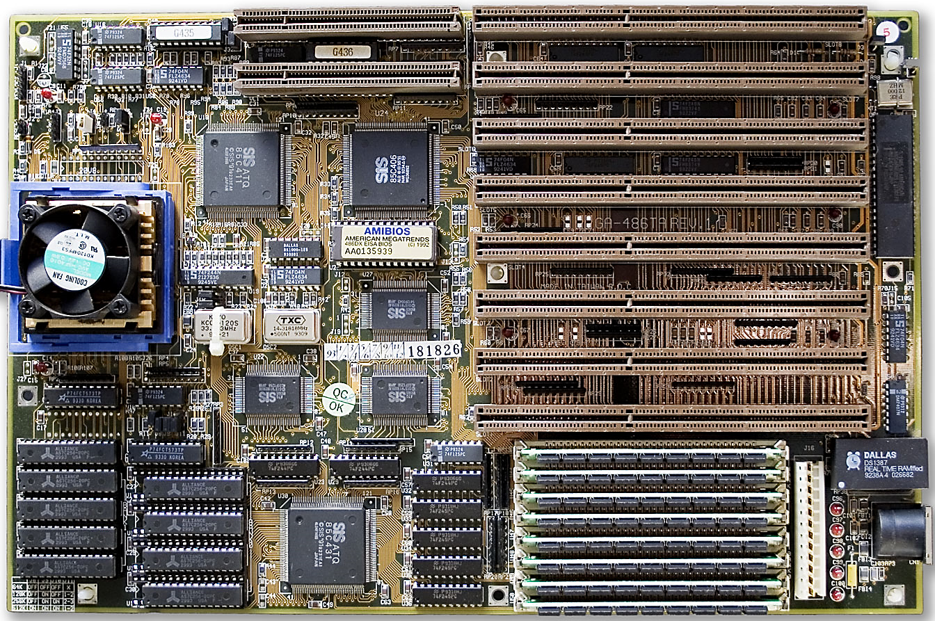

ATX Form Factors
CPU Socks
2
PCI slots
1

Slide 10
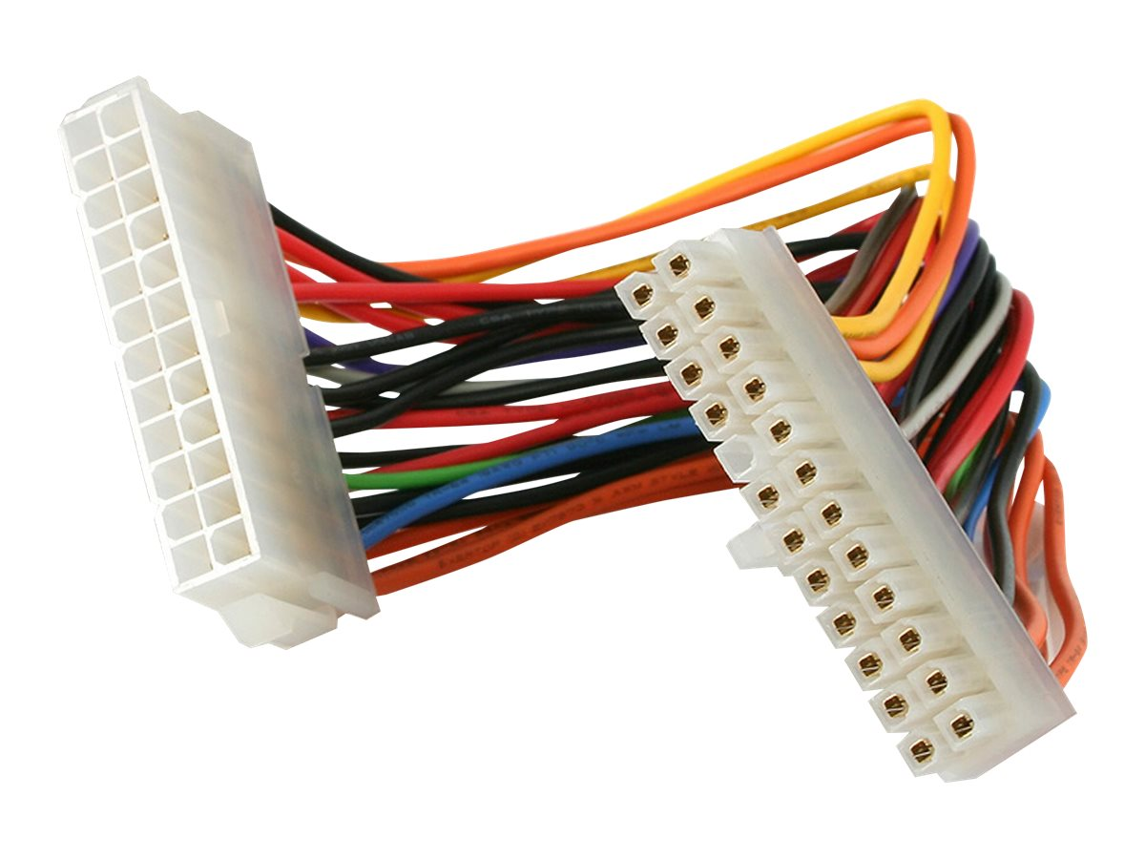
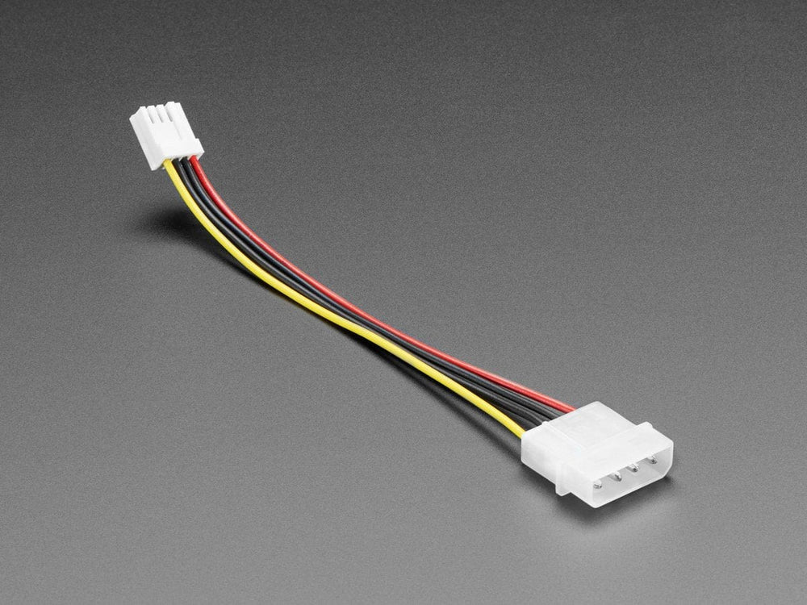
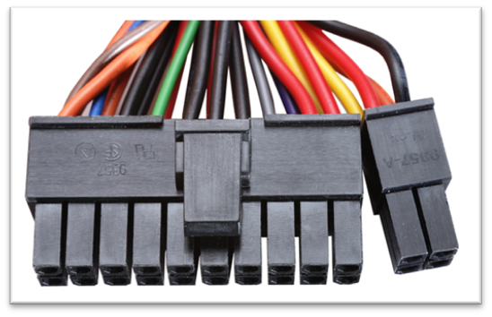
1. Feature ATX Form Factors
ATX P1 Connectors 20 points
ATX 2.1
UPU connectors 12 V
ATX 24 (20 +4) p1 Connectors

Slide 11
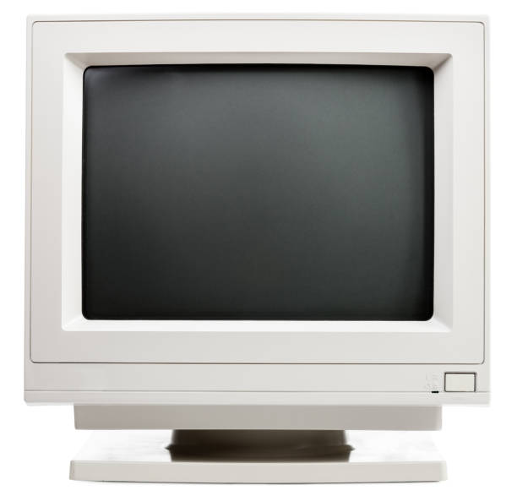
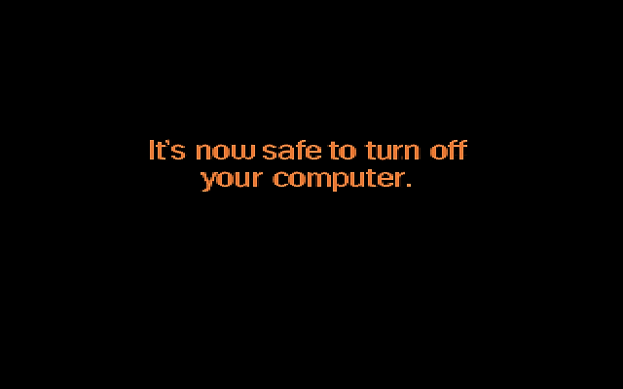

2. Feature ATX Form Factors
An ATX motherboard includes the soft switch feature, sometimes referred to as the soft power feature."

Slide 12
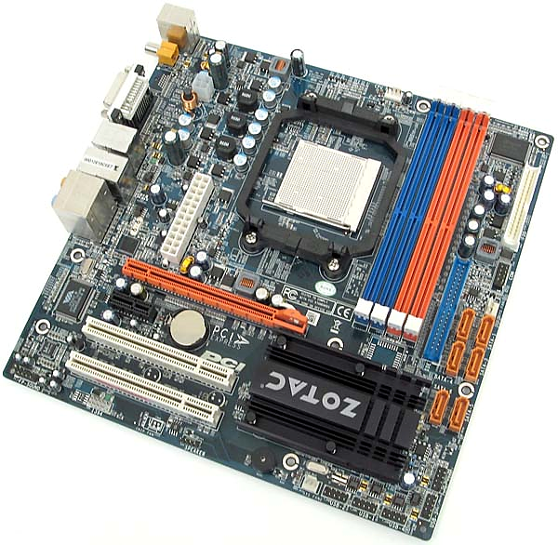
Micro ATX Form Factor Feature
9.6* 9.6 Inch
PCI Slots less than 3
Less power
Lower price

Slide 13
BTX Form factors
BTX sands Balanced Technology eXtended
It was developed by Intel in 2003
12 Inch
Its dimensions are 12*9.6
10.5 Inch

Slide 14
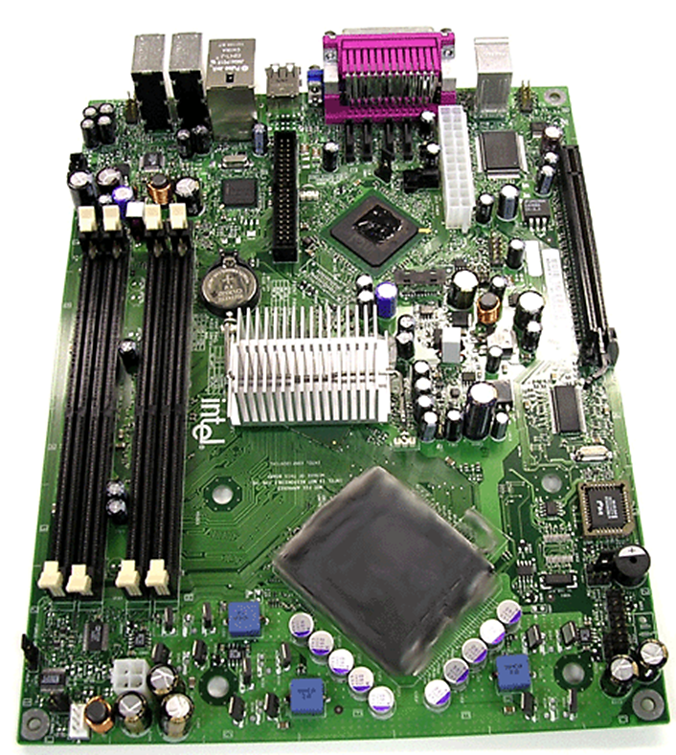
Feature BTX Form Factors
CPU Sekts

Slide 16
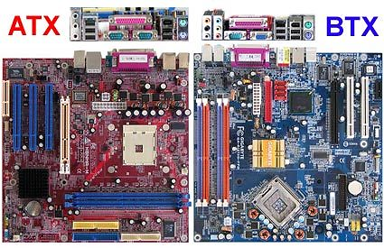
ATX & BTX
ATX | BTX

Slide 17
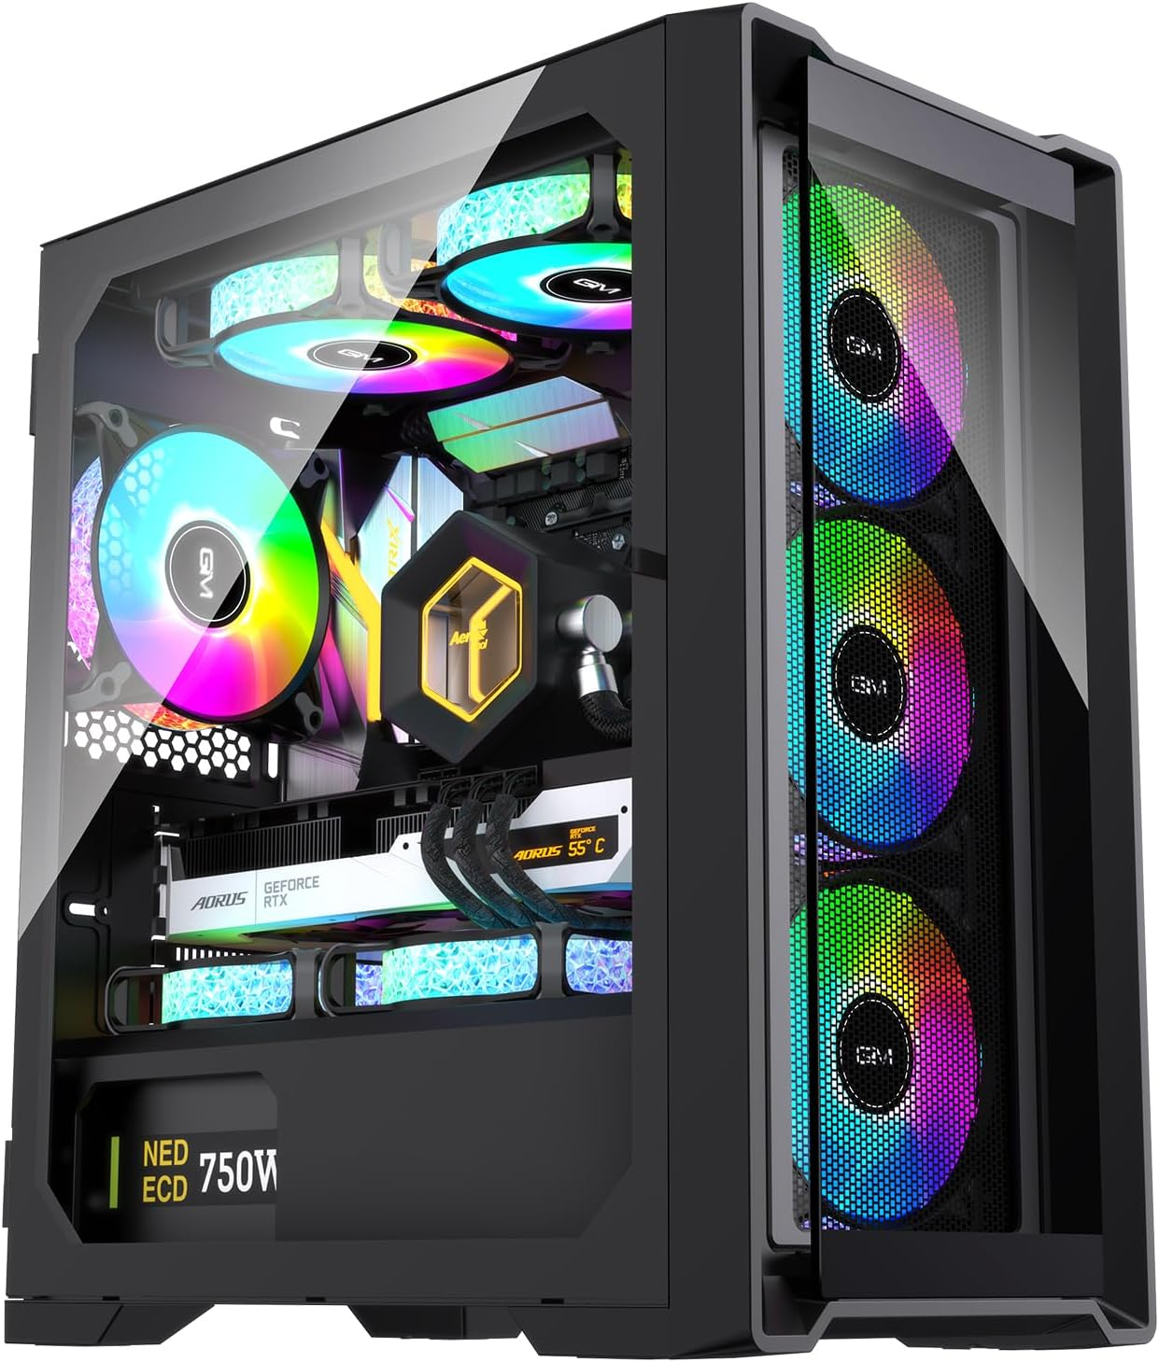
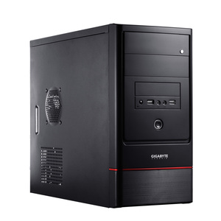
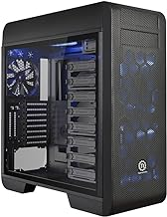
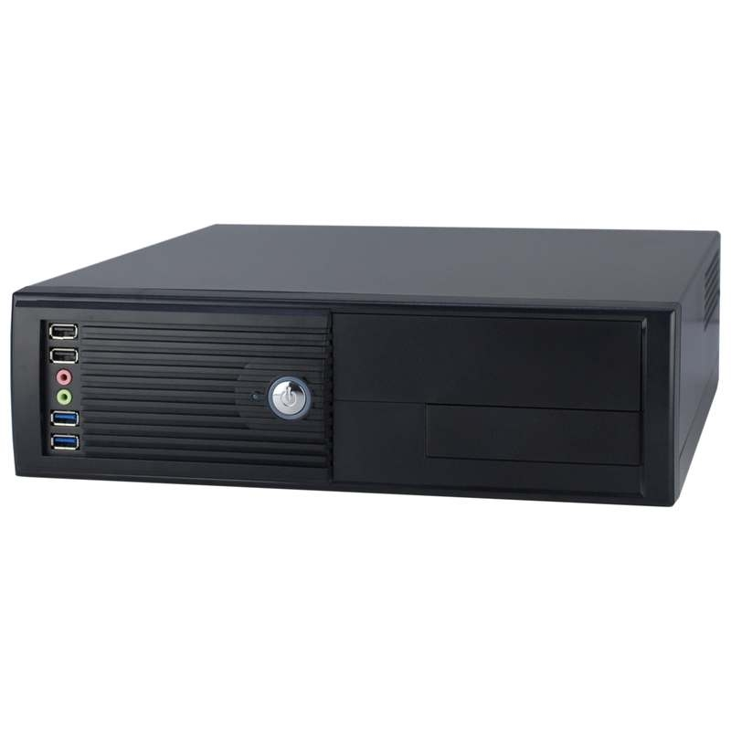
Types Of Computer Cases
Full Tower Case:
Size: Large (55 cm tall).
Supports: ATX, EATX
Best For: High-performance.
Midsize Tower Case:
Size: Medium (45-55 cm tall).
Supports: ATX, Micro-ATX, Mini-ITX.
Best For: Most standard
desktop builds
MinTower Case:
Size: Smaller than (35-45 cm tall).
Supports: Micro-ATX and Mini-ITX
Best For: Budget builds, home office
Desktop Case
Size: Thin and flat
Supports: Mini-ITX, Micro-ATX
Best For: Offices, simple desktop builds, and environments with limited space.

Slide 18

Tank you

